Slide 1


MASTERCLASS · AI FOR CONTENT CREATION
Your stories,
told faster.
The basics of AI and prompting, before we build.
ASEAN Oct 2026
Notes:
~30 sec. Welcome. Set expectations: 20 minutes of basics, no maths, no jargon, then straight into hands-on. Ask for a quick show of hands: who has used ChatGPT, Gemini or Claude for work this month?

Slide 2
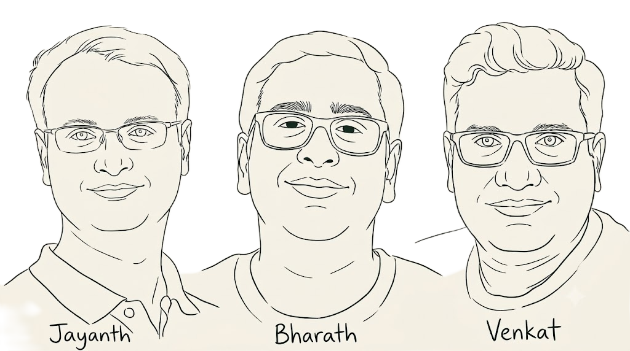
About Us

Slide 3



Small teams. Big stories.
You have more impact to share than hands to share it.
Every channel
Many audiences
Many languages
Instagram, LinkedIn, newsletters, WhatsApp, every single week.
Customers, buyers, funders, partners and the communities you serve.
English for funders, local languages for customers and communities.
AI won't replace your storytelling. It can give you back the hours.
Notes:
~1.5 min. Anchor in their reality before any technology. Most marketing teams in social enterprises are one to three people doing the work of a whole agency, across channels, audiences and languages. Ask: which of these three stretches your team most? Frame AI as capacity, not replacement.

Slide 4
What is a large language model?
WHAT COMES NEXT?
"Our compost turns kitchen waste into ___"
A prediction engine that has read more text than any person ever could.
rich soil
It writes one word at a time, always choosing a likely next word. That's why it sounds fluent, and why fluent isn't the same as true.
fertiliser
gold
Illustrative, not real probabilities
Notes:
~2 min. The one idea: it predicts the next likely word, over and over. Walk through the compost example: "rich soil" is most likely, "gold" is possible but unlikely. Then land the key point for marketers: because it always produces something likely-sounding, it will sound confident even when it is wrong. Fluent is not the same as true.

Slide 5

How it learned, in three steps
01
02
03
Read
Coached
Refined
Trained on a vast library of books, websites and articles.
Shown many examples of good answers. Learned to follow instructions.
People rated its answers. Learned what "helpful" looks like.
WHAT THIS MEANS FOR YOU
It learned from everyone, so it sounds like everyone. Make it sound like you.
Notes:
~1.5 min. Keep it light: read, coached, refined. No need for technical terms. The takeaway is the dark box: because it learned from the whole internet, its default voice is the average voice. That is why unedited AI content feels generic. Everything in the prompting section is about pulling it away from average and toward your brand.

Slide 6




Think of it as a brilliant intern on their first day
Widely read
Knows nothing about you
Broad knowledge on almost any topic, available instantly.
Your mission, your protagonists, your brand voice: you have to tell it.
Eager to please
Needs your direction
Rarely says "I don't know". It fills gaps with confident guesses.
Great work comes from a clear brief and your final review.
Notes:
~1.5 min. This is the mental model to keep all day. Ask the room: how would you brief a new intern on day one? You would not just say "write something about us". You would explain who you are, who the audience is, and show examples. Same with AI. And you would never publish an intern's first draft without reading it.

Slide 7


Where it shines, where it stumbles
Shines
Stumbles
First drafts in seconds
Ten headline options instead of one
Rewriting one story for many audiences
Translating and localising across languages
Turning long reports into short posts
Inventing facts, figures and quotes
A generic, over-polished "AI voice"
Not knowing your context or community
Missing local and cultural nuance
Not knowing recent events
Use it for speed and range. Bring the facts, the context and the voice yourself.
Notes:
~2 min. Left column is where to lean in. Localising is a big one for teams across Southeast Asia: one story adapted for English-speaking funders and local-language customers. Right column is where to stay alert. The first item matters most for impact brands: it will happily invent a number like "reduced waste by 40%" if you do not give it your real data.

Slide 8


The tools you'll meet
Chat assistants
Inside your apps
Image and video
ChatGPT · Claude · Gemini
Canva · Google Workspace · Microsoft 365 · Meta
Canva · Adobe Firefly · Google Vids · Gemini Canvas
Writing, brainstorming, editing and research.
AI help right where you already work.
Visual drafts, variations and resizing.
The tool matters less than the brief you give it.
Notes:
~1 min. Keep this quick; do not turn it into a product comparison. Point out that many of them already have AI inside tools they use daily, like Canva. The key message is the last line: skills transfer across tools, because they all respond to the same thing, a good brief. That is our bridge to prompting.

Slide 9
PART TWO · PROMPTING
A prompt is a
creative brief.
If you can brief a designer or an agency, you already know how to prompt.
Notes:
~30 sec. Pause here. This is the reframe that makes marketers confident: prompting is not a technical skill, it is briefing, which they already do every week. Let it land, then move on.

Slide 10
Five parts of a good brief
Example: an Instagram caption for a rice brand working with smallholder farmers
ROLE
"You are the social media writer for [Brand], an impact brand."
TASK
"Write an Instagram caption announcing our new harvest."
CONTEXT
"We buy organic rice directly from smallholder farmers in [region]. Our followers are young urban families who care where their food comes from."
FORMAT
"Under 80 words. Warm, not preachy. End with a question. Three hashtags."
EXAMPLES
"Here are two past posts that sound like us: [paste posts]"
Notes:
~2.5 min. Map each part to something they already put in an agency brief: role is who is writing, task is the deliverable, context is the background and audience, format is the specs, examples are the mood board. Context and examples are where most of the quality comes from, and they are the parts people most often skip.

Slide 11
Same request, two briefs
VAGUE
SPECIFIC
"Write a post about our recycling."
"You are the comms lead at [Brand], which turns discarded fishing nets into [product] in [country]. Write a LinkedIn post for corporate buyers about our new collection. Confident, not preachy. About 120 words. Use only these facts: [facts]. End with a clear call to action."
You get: generic copy that could be any brand, possibly with an invented statistic.
You get: on-brand, factual copy that's nearly ready to publish.
Notes:
~2 min. Read both aloud. Point to "Use only these facts" in the specific brief: that single line is the best protection against invented impact numbers. If time allows, invite someone to suggest one more line they would add to the specific brief.

Slide 12
Five moves that make the difference
1
Show your voice
"Here are three of our past posts. Match this tone."
2
Ask for options
"Give me ten headlines, from playful to serious."
3
Let it interview you
"Before you write, ask me three questions."
4
Edit like an editor
"Shorter. Warmer. Cut the jargon."
5
Ask for a critique
"What would a sceptical buyer question in this post?"
The first answer is a first draft. Keep the conversation going.
Notes:
~2 min. These are the moves they will practise in the hands-on. Number 3 is the one most people have never tried and it surprises them: the AI asks you the questions a good copywriter would. Number 5 turns the AI into a reviewer, useful before anything goes to funders.

Slide 13




Four guardrails for impact brands
Check every number
Protect people
Your impact claims are your credibility. An invented statistic is greenwashing, even by accident.
Keep beneficiary names, photos and donor data out of public AI tools.
Keep your voice
Be honest with images
Edit until it sounds like you. Your community will notice if it doesn't.
Never present AI-made images of people, communities or places as real.
Notes:
~2 min. This is the slide that is specific to social enterprises. Their brand rests on trust with customers, funders and communities. An AI-invented impact figure or a fake photo of "our farmers" can undo years of credibility. Protecting beneficiary data is both an ethical and, in several countries, a legal matter.

Slide 14



ONE IDEA TO TAKE WITH YOU
When first drafts are free, judgment becomes the scarce skill.
AI drafts. You decide.
Up next: a live demo, then your turn.
Notes:
~1 min. Close the loop: speed is now cheap, so the value marketers bring shifts to judgment, knowing their audience, their facts and their voice. Then transition straight into the hands-on.

Slide 15
LIVE DEMO · WATCH FIRST
Picker stories:
Ibu Sari.
The same four prompts you'll use next. Watch what I type, and what I check.
1 · Caption
2 · Video plan
3 · Hashtags
4 · Three variations
Notes:
Demo framing, about 30 seconds. Tell people they do not need to type along; the hands-on repeats exactly these four steps with the Loop Tote. Ask them to watch two things: how the prompt is built, and what you check before accepting the output.

Slide 16
LIVE DEMO · THE BRIEF
Meet Ibu Sari
WHO
Ibu Sari, waste picker at Hub 2, Cimahi
THE REEL IDEA
HER WORK
Picking since 2018 · sorts 200 kg of plastic a day
A portrait interview.
BEFORE
“I sold to whoever paid a little more that day.”
Ibu Sari at her sorting table. Natural light, handheld, warm and unhurried. Subtitles on.
NOW
Registered, weighed on a public scale, paid fair-trade rates the same day
IN HER WORDS
“My children can plan now. That's the difference.”
NETWORK
One of 3,500 pickers registered with LoopCycle Nusantara
Instagram Reel · about 10 seconds
Real footage of a real person
Notes:
Point out the difference from the Loop Tote: this story is about a real person. Her quotes are sacred; the AI may shape the text around them but must never rewrite them. Paste this brief as text into the chat for the demo.

Slide 17
LIVE DEMO · STEP 1 OF 4
Write the caption and on-screen text
1
New chat. Paste the prompt, then the Ibu Sari brief.
THE PROMPT I'M USING
2
Read the first draft aloud. Does it sound like us?
You are the social media writer for LoopCycle Nusantara, an Indonesian social enterprise that works with registered waste pickers.
Write the text for an Instagram reel about one of our pickers:
1. A caption: a hook, two short paragraphs, then a question that invites comments. Under 100 words.
2. Three lines of on-screen text: an opening hook, a middle line and an end card.
Tone: warm and respectful. She is the hero, not us. Use only the facts and quotes below, and never change her words.
[Paste the Ibu Sari brief]
3
Refine: “Less about us, more about her.”
4
Check: every number and quote matches the brief, word for word.
Notes:
Show the first draft, then the refinement. Drafts often drift into brand self-praise; the follow-up pulls the focus back to her. Read her quotes in the output against the brief out loud so the room sees the check happen.

Slide 18
LIVE DEMO · STEP 2 OF 4
Plan the video around real footage
1
Stay in the same chat.
THE PROMPT I'M USING
2
Paste the prompt. Note the key line: “do not use real people to generate the reel.”
Now act as a documentary video editor. This reel uses real interview footage of Ibu Sari, so do not use real people to generate the reel.
Write a 10-second edit plan for a vertical (9:16) reel, shot by shot with timings: which clip, on-screen text, subtitles, music mood and transitions.
Clips we have: her interview at the sorting table, weighing at the hub scale, the receipt slip handed over. End card: LoopCycle Nusantara · 3,500 registered pickers.
Also list any extra shots we should film at the hub.
3
Hand the plan to whoever edits, or use AI only for text and the end card.
4
Check: real person, real footage, and her consent to share her story.
Notes:
This is the deliberate contrast with the hands-on. For a product like the Loop Tote, AI video is fine. For a real person's story, AI plans the shoot and the edit; it does not fabricate her. Mention consent: she should know how and where her story will be used.

Slide 19
LIVE DEMO · STEP 3 OF 4
Find the right hashtags
1
Stay in the same chat.
THE PROMPT I'M USING
2
Paste the prompt.
You are back to social media writer for LoopCycle Nusantara
Suggest 12 Instagram hashtags for this reel:
– 3 for LoopCycle and a picker stories series
– 5 on the topic: waste pickers, fair trade, circular economy
– 4 local: Bandung, Cimahi, West Java, Indonesia
Mix popular and niche tags. Give one line on why each fits, then mark the 5 you would use.
Flag any tag that could feel pity-driven or exploitative.
3
Refine: “Which of these would our pickers be proud to see?”
4
Check: search each tag on Instagram. Active, on-topic, not spammy?
Notes:
The last line of the prompt is the teaching point: dignity. Stories about low-income workers can slide into poverty imagery. Ask the AI to flag it, then apply your own judgment.

Slide 20
LIVE DEMO · STEP 4 OF 4
Create three variations
1
Stay in the same chat.
THE PROMPT I'M USING
2
Paste the prompt.
Write 3 variations of the caption, each with 5 hashtags:
A. Her voice: open with her own quote
B. The change: life before and after registering
C. The bigger picture: one of 3,500 pickers
Keep every fact and quote identical. Under 100 words each. Label them A, B and C.
Then add a short table comparing the hook, tone and best audience for each.
3
Ask: “Which would you post first, and why?”
4
Check: are her quotes and the facts identical in all three?
Notes:
Show the table and pick one live, explaining why. Variation A usually wins for picker stories because her voice carries it. Then move to the comparison slide.

Slide 21
PART THREE · HANDS-ON
Launch the Loop Tote.
Four prompts, one launch reel. Work at your own pace in ChatGPT, Claude or Gemini.
1 · Caption
2 · Video prompt
3 · Hashtags
4 · Three variations
Notes:
Set up the hands-on. Everyone works on the same fictional-style launch so results can be compared. Suggest roughly 8 to 10 minutes per step. Steps 2 to 4 happen in the same chat as step 1, so the AI remembers the caption. Share the Loop Tote brief as copyable text (chat, WhatsApp or a shared doc) so people can paste it.

Slide 22
HANDS-ON · THE BRIEF
Meet the Loop Tote
PRODUCT
A sturdy everyday tote bag
THE REEL IDEA
MADE FROM
14 plastic bottles per tote
Fast, tactile product reveal.
SOURCED
Collected by registered pickers across West Java
MADE
Washed at our Bandung plant, then woven
A pile of 14 clean bottles on a table, then cut to the finished tote in three colours against a Bandung street.
COLOURS
Sea-green, indigo, sand
IMPACT
Every purchase pays pickers fair-trade rates
Instagram Reel · about 10 seconds
Launch: Sat 10 Oct 2026
LAUNCH
https://looptote.netlify.app/
Notes:
This is the only source of facts for the whole exercise. Remind people: if a number or claim is not on this slide, it should not appear in their content. Share this as text so they can paste it into their chat.

Slide 23
HANDS-ON · STEP 1 OF 4
Write the caption and on-screen text
1
Open a new chat in ChatGPT, Claude or Gemini.
COPY THIS PROMPT
2
Copy the prompt, fill in the [brackets] and paste the Loop Tote brief at the end.
You are the social media writer for Loop Tote, an Indonesian impact brand that makes bags from recycled plastic bottles.
Write the text for our Instagram launch reel:
1. A caption: a hook under 8 words, two short paragraphs, then a call to action. Under 90 words.
2. Three lines of on-screen text: a hook, a middle line and a closing line.
Audience: [who you want to reach]. Tone: warm and proud, not preachy. Use only the facts below and add no new numbers.
[Paste the Loop Tote brief]
3
Refine once: “Make the hook more surprising” or “Ask me 3 questions first.”
4
Check: 14 bottles, West Java, Bandung, three colours. Nothing invented?
Notes:
About 8 to 10 minutes. The most common slip is the AI inventing a figure, like tonnes of plastic saved. Ask people to check their caption line by line against the brief. If they finish early, try the “ask me 3 questions first” follow-up and compare.

Slide 24
HANDS-ON · STEP 2 OF 4
Turn it into a video prompt
1
Stay in the same chat, so it remembers your caption.
COPY THIS PROMPT
2
Paste the prompt. Adjust the scenes if you have a better idea.
Now act as a video director. Write a prompt for an AI video tool to create a 10-second vertical (9:16) Instagram reel for this launch.
Describe it shot by shot with timings: what we see, camera movement, lighting, on-screen text and mood.
Story: a pile of 14 clean plastic bottles on a table → washing, shredding, yarn, weaving → the finished tote in sea-green, indigo and sand, carried on a Bandung street.
Fast, tactile, bright daylight. Use the on-screen text you wrote. Under 150 words, plain language, no other brands or logos.
3
Copy the result into your team's AI video tool and generate.
4
Check: never show AI-made “pickers” as real people. Real faces need real footage.
Notes:
About 8 to 10 minutes. Not everyone will have a video tool; the prompt itself is the deliverable. Point out the guardrail: AI video of workers or pickers must not be passed off as the real community. Product and process shots are fine.

Slide 25
HANDS-ON · STEP 3 OF 4
Find the right hashtags
1
Stay in the same chat.
COPY THIS PROMPT
2
Paste the prompt.
Suggest 12 Instagram hashtags for this post:
– 3 for the brand and campaign (always include #LoopTote)
– 5 on the topic: recycled fashion, plastic, sustainability
– 4 local ones for Indonesia and Bandung
Mix popular and niche tags. Give one line on why each fits, then mark the 5 you would use.
3
Refine: “Which of these are overused or too broad?”
4
Check: search each hashtag on Instagram. Is it active and on-topic?
Notes:
About 5 to 8 minutes. The AI cannot see live Instagram data, so it may suggest tags that are dead, spammy or dominated by unrelated content. The manual check in step 4 matters.

Slide 26
HANDS-ON · STEP 4 OF 4
Create three variations
1
Stay in the same chat.
COPY THIS PROMPT
2
Paste the prompt.
Write 3 variations of the caption, each with 5 hashtags, from three angles:
A. The people: the pickers of West Java and fair-trade pay
B. The style: three colours for everyday life
C. The number: 14 bottles, 1 bag
Keep every fact the same. Under 90 words each. Label them A, B and C.
Then add a short table comparing the hook, tone and best audience for each.
3
Ask: “Which would you post first, and why?”
4
Check: are the facts identical in all three? Pick the one you would publish.
Notes:
About 8 to 10 minutes. Variations are where AI saves the most time: one story, several angles, ready for A/B testing or different channels. Ask two or three people which angle they picked and why.

Slide 27
HANDS-ON · COMPARE
How does yours compare?
What did your version do better?
What did the brand include that yours missed?
Which of your variations would you publish?
THE BRAND'S LAUNCH CAPTION
14 bottles. 1 bag. Meet the Loop Tote ♻️
Every tote is made from 14 plastic bottles collected by registered pickers across West Java, washed at our Bandung plant and woven into a sturdy everyday bag. Now available in three colours. Every purchase pays pickers fair-trade rates, for real. Tap the link in bio to get yours.
#LoopTote #recycledfashion #sustainablestyle #plasticfree #madeinindonesia
BONUS PROMPT
Engagement question: “Which colour are you? Sea-green, indigo or sand?”
“Write alt text for this reel for people using screen readers, and one question to spark comments.”
Notes:
Share-back, about 5 minutes. The brand's own post is a reference, not the "right answer". Notice two things it has that most AI drafts miss: alt text for accessibility and a simple engagement question. Close by asking what surprised people most.

Slide 28
PART Four · REVIEWS & COMMENTS
Analyze Customer Reviews
5 questions, 5 prompts — 358 product reviews · 1,515 Instagram comments · 8 platforms

Slide 29
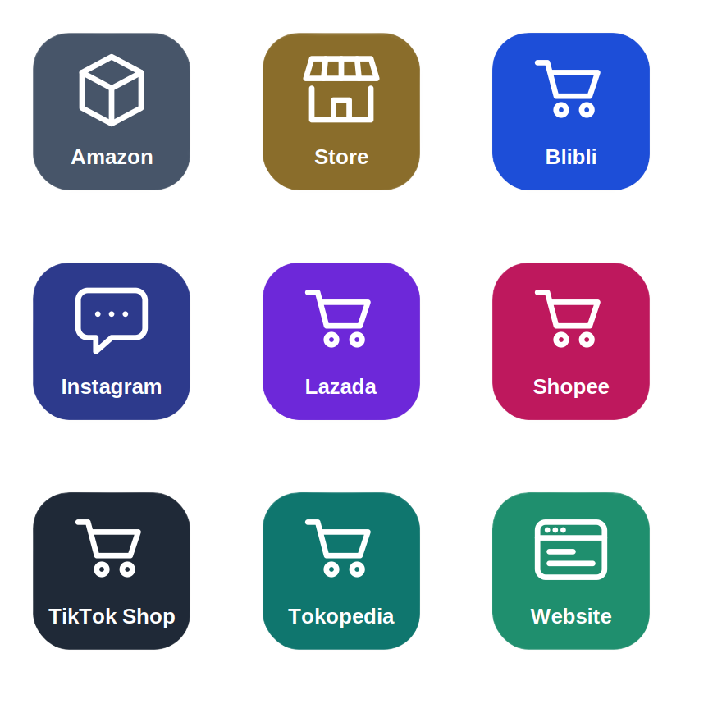
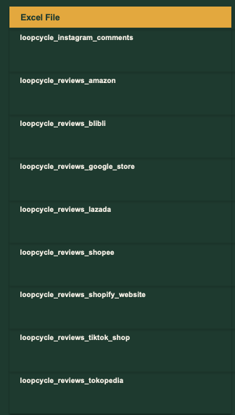
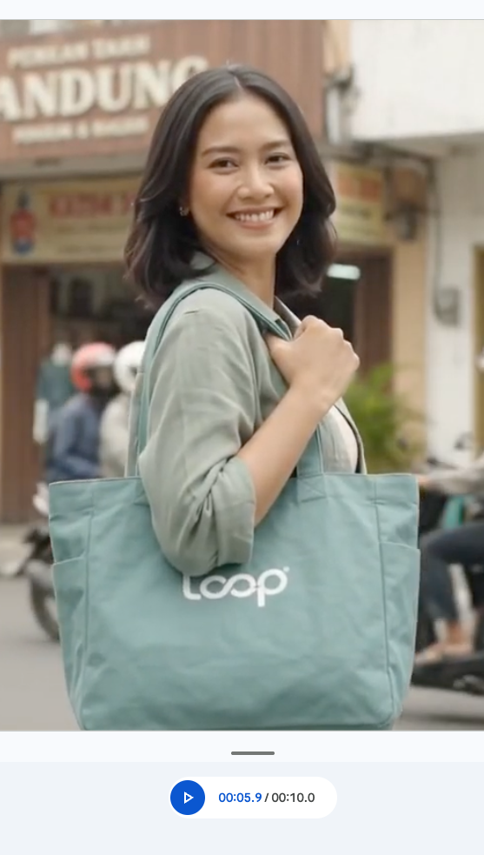
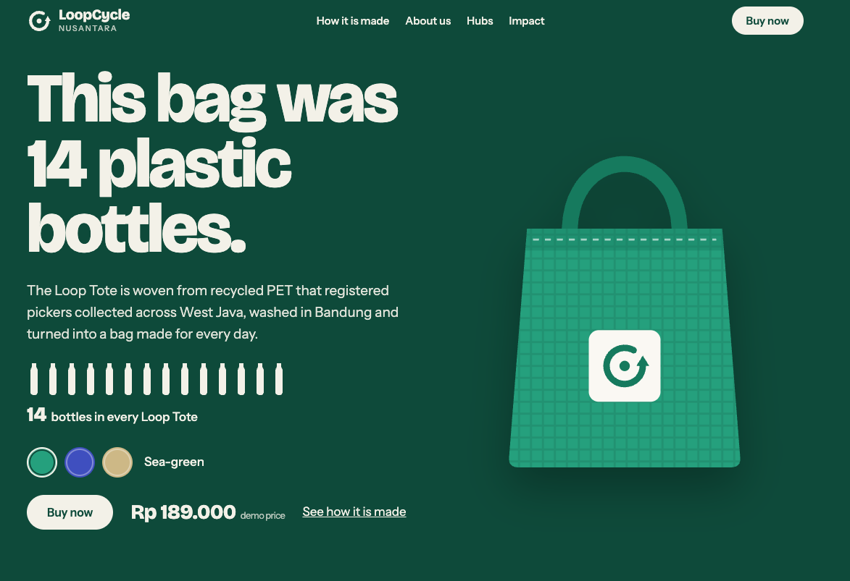
REVIEWS & COMMENTS · SETUP
The Story So Far…
Designed an Insta Reel to launch Loop Tote
Launched Loop Tote
Loop Tote sold on various platforms
Reviews & Comments from various platforms

Slide 30
REVIEWS & COMMENTS · SETUP
We will try and answer the following 5 questions:
1. What are customers really saying?
2. Is the problem the product, or everything around it?
3. How do platforms differ, and are we responding where it matters?
4. What are people saying on Instagram, and which comments stop them buying?
5. What should we fix, say and measure next?

Slide 31
REVIEWS & COMMENTS · SETUP
What we will be using
Files you need
Review files (one per platform)
loopcycle_reviews_amazon.csv
loopcycle_reviews_blibli.csv
loopcycle_reviews_google_store.csv
loopcycle_reviews_lazada.csv
loopcycle_reviews_shopee.csv
loopcycle_reviews_shopify_website.csv
loopcycle_reviews_tiktok_shop.csv
loopcycle_reviews_tokopedia.csv
(358 reviews in total — column names differ by platform)
loopcycle_instagram_comments.csv
1,515 comments on 8 Loop Tote posts, including brand replies.
loopcycle_tote_orders.csv (optional)
Link reviews to orders for delivery-time follow-ups.

Slide 32
REVIEWS & COMMENTS · SHARED CONTEXT
Paste this first — before any question
You are a customer-insight analyst helping a small social enterprise.
Context: LoopCycle Nusantara (Bandung, Indonesia) sells the Loop Tote, a tote bag made from 14 recycled bottles, sourced from registered waste pickers. Our platforms: Shopee, Tokopedia, TikTok Shop, Lazada, Blibli, Shopify website, Amazon, Google store, and Instagram (@loopcycle.nusantara).
Data (all English):
- 8 review CSV files (358 reviews total). Column names differ by platform.
Amazon: rating | review_title + review_text | review_date
Shopee: rating_star | comment | seller_reply | create_time (Unix)
Tokopedia: rating | review_message | seller_response | review_time
TikTok Shop: review_rating | review_content | seller_reply
Lazada: product_rating (+ seller_rating, delivery_rating) | review_title
Blibli: rating | review_content | merchant_reply | review_date (dd/mm/yyyy)
Shopify website: rating | review_title + review_body | merchant_reply
Google store: star_rating | review_text | owner_response
- loopcycle_instagram_comments.csv: 1,515 comments on 8 posts.
Replies have a non-blank parent_comment_id.
- The last two columns (synthetic_sentiment_label, synthetic_topic)
are answer keys — do not use them until I ask you to.
Rules: use only the data I give you. Show how many reviews or comments sit behind every figure. Say clearly when a sample is too small to draw conclusions. Never invent data or quotes.
1
Open a new chat in ChatGPT, Claude or Gemini.
2
Paste this context block first.
3
Attach the review files and / or the Instagram comments file.
4
Then paste your question prompt.
5
Keep the same chat open for all 5 questions.

Slide 33
REVIEWS & COMMENTS · QUESTION 1 OF 5
What are customers really saying?
Using the attached review and comment files:
1. Combine the 8 review files. Flag which columns you used for rating, review text, reply and date on each platform.
2. Classify each review as: positive, neutral, negative, or unrelated (complaint is not about the product). Show your count for each label.
3. For each label, list the top 3 topics with counts.
4. List 5 reviews a human should read first and explain why.
5. Now check your labels against synthetic_sentiment_label. Show a confusion matrix and explain where you went wrong.
Files: all 8 review CSVs
Do not use the synthetic_ columns until step 5.
1
Attach all 8 review files.
2
Paste the prompt.
3
Follow-up: "Where did the star rating mislead you — e.g. a positive review with 4 stars or an unrelated review with 4 stars?"
4
Ask: "Which reviews should a human read first, and why?"

Slide 34
REVIEWS & COMMENTS · QUESTION 2 OF 5
Is the problem the product, or everything around it?
Use the combined review table (or rebuild it).
1. Split reviews into: about the product, about delivery or packaging, about seller service, about the store, or other.
2. Calculate the average rating overall and for product-focused reviews only. Show the difference.
3. List the top product issues and top non-product issues with counts and one example quote per issue.
4. Show by platform how much of the low-rating problem is non-product. Flag platforms where this is over 20%.
5. Tell me which three things we should fix first, and why.
Follow-up:
if I also give you loopcycle_tote_orders.csv, how would you check whether delivery complaints match longer delivery times? Describe the join and columns, then do it.
1
Reuse the same chat (combined table already in context).
2
Paste the prompt.
3
Follow-up: "Separate what is being complained about from how unhappy the customer is."
4
Optionally attach loopcycle_tote_orders.csv for the join.

Slide 35
REVIEWS & COMMENTS · QUESTION 3 OF 5
How do platforms differ, and are we responding where it matters?
1. Compare each platform: number of reviews, average rating, sentiment mix, average review length, reply rate.
2. Show the seller reply rate by sentiment (positive, neutral, negative, unrelated). Which groups do we reply to most?
3. Which kinds of reviews get no reply? What is the risk or opportunity in each case?
4. Identify two things that look like platform differences but could be caused by sample size or different review prompts.3
5. Recommend a reply policy: which reviews we answer within 24 hours, which later, and which we can skip.
Follow-up: Write three reply templates (delivery delay, product defect, neutral feedback) in our brand voice:
warm, direct, no jargon.
1
Reuse the same chat.
2
Paste the prompt.
3
Follow-up: "Write three reply templates in our brand voice: warm, direct, no jargon."
4
Ask: "Which platform comparison is least trustworthy because of sample size?"

Slide 36
REVIEWS & COMMENTS · QUESTION 4 OF 5
What are people saying on Instagram, and which comments stop them buying?
Use loopcycle_instagram_comments.csv. Ignore the synthetic_ columns until step 5.
1. Separate top-level comments (parent_comment_id blank) from replies. Count each group.
2. Classify top-level comments as: praise, question, objection (price / trust / quality / availability), or noise (spam, quiz guesses, off-topic).
3. For each group, calculate the share that received a brand reply. Which groups do we reply to least?
4. Compare posts: which attract the most questions, objections and complaints?
5. Check your classification against synthetic_topic and synthetic_sentiment_label. Where did you go wrong?
6. Give 5 recommendations for managing comments, including three reusable reply templates.
1
Attach loopcycle_instagram_comments.csv.
2
Paste the prompt.
3
Follow-up: "Estimate how many potential buyers these unanswered comments might represent, and say what we cannot know from this data."
4
Optionally attach loopcycle_post_kpis.csv for post context.

Slide 37
REVIEWS & COMMENTS · QUESTION 5 OF 5
What should we fix, say and measure next?
Using the review and comment findings from this conversation:
1. Compare themes across reviews and comments: what appears in both, only in reviews, or only in comments?
2. Build a prioritised action list of at most 8 items across product, logistics, content, and community management.
3. Write the content we should publish: three FAQ-style Instagram posts that address the top objections (price, sustainability trust, quality).
4. Propose 5 KPIs to track monthly (e.g. share of 1–2 star reviews that are non-product, reply rate for objections).
5. List what this data cannot tell us and what extra data we should collect.
6. Finally, argue against your own priorities: what would make them wrong?
1
Stay in the same chat (all previous findings in context).
2
Paste the prompt.
3
Follow-up: "Turn this into a one-page brief for the founder."
4
Ask: "Which three actions could we start this week without spending money?"

Slide 38
LIVE DEMO ·
Chatbot Agent
1 · FAQ
2 · Product
3 · Order
4 · Returns
Notes:
Demo framing, about 30 seconds. Tell people they do not need to type along; the hands-on repeats exactly these four steps with the Loop Tote. Ask them to watch two things: how the prompt is built, and what you check before accepting the output.

Slide 39
MASTERCLASS · AI FOR CONTENT CREATION
Thank You
ASEAN Oct 2026
Notes:
~30 sec. Welcome. Set expectations: 20 minutes of basics, no maths, no jargon, then straight into hands-on. Ask for a quick show of hands: who has used ChatGPT, Gemini or Claude for work this month?

